Slide 1

Basaveshwar Engineering College Bagalkote
Department of Artificial Intelligence and Machine Learning
MINI PROJECT
Detection of Kidney Stones
Project coordinate: Project Guide: Prof. L.P. Kolur Dr. V.C.Kagawade
GROUP MEMBERS
SL.NO | NAME | USN
1. | Harish G Rolli | 2BA21AI021
2. | Subramanya Ratnakar | 2BA21AI052
3. | Mohanrao Kulkarni | 2BA21AI028
4. | Veeresh Pattanad | 2BA21AI061

Slide 2

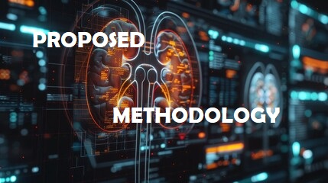
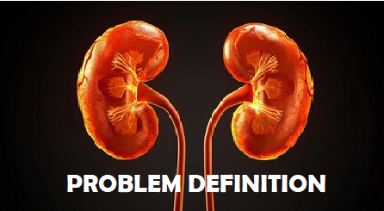
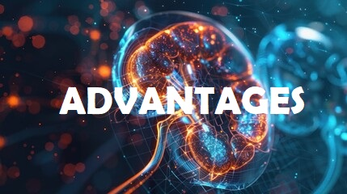


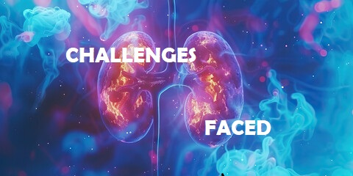

TABLE OF CONTENT

Slide 3
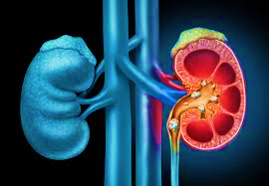
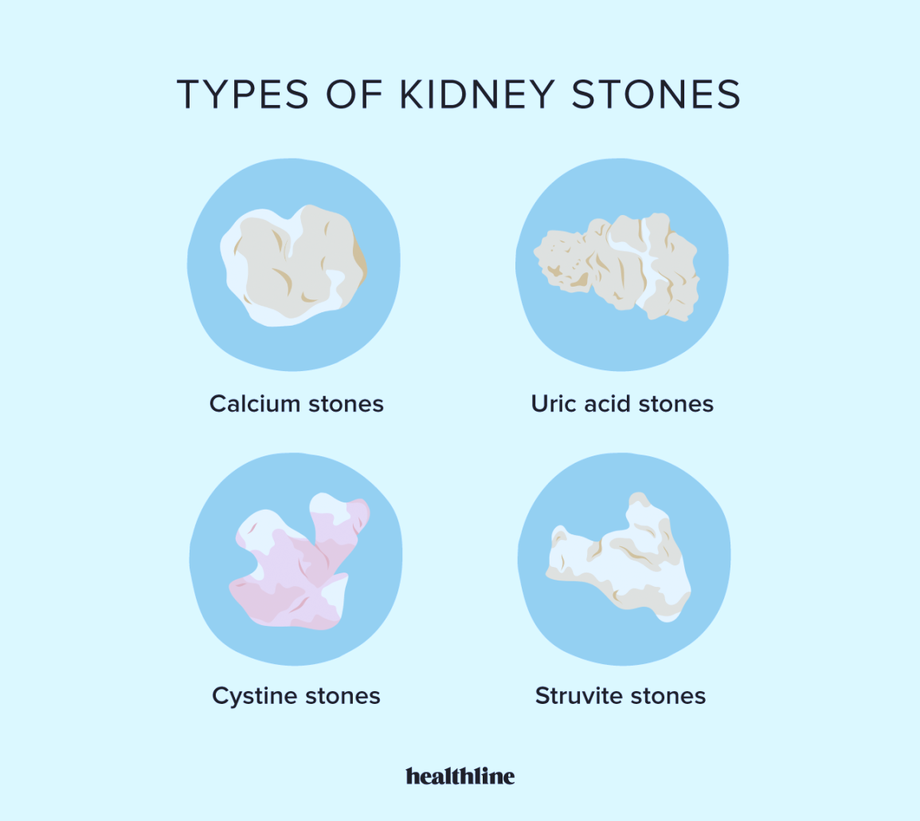
INTRODUCTION
what are Kidney Stones?
Crystallized structures: Imagine tiny, hard clumps formed from minerals normally dissolved in urine.
Mineral source: Minerals in your diet can contribute to these clumps, like calcium or uric acid.
Size variation: These clumps can be as small as of sand or grow as large as a golf ball.
Painful passage: When stones move through the narrow tubes (ureters) that carry urine, it can cause severe pain.
Complications: If left untreated, stones can lead to infections and even damage your kidneys.
Traditional Diagnostic Methods (Limitations):
X-rays: These pictures can be helpful, but they might miss smaller stones that are hiding behind bones or tissue.
Urinalysis: This analyzes your urine for abnormalities, but it can't tell the doctor the size or location of any stones that might be present.

Slide 4
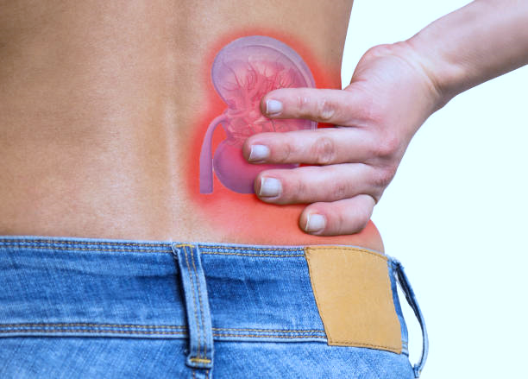
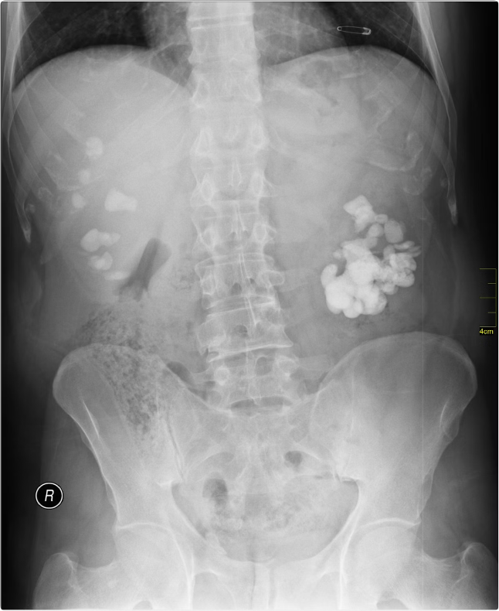
Modern Diagnostic Techniques:
Computed Tomography (CT): This creates detailed cross-sectional images of your body, allowing doctors to see even tiny stones. However, CT scans involve radiation exposure.
Ultrasound: This uses sound waves to create an image of your kidneys and ureters. It's safe, painless, and doesn't use radiation, making it a good option for pregnant women and children.
Magnetic Resonance Imaging (MRI): This uses strong magnets and radio waves to create detailed images. It's helpful for some cases but can be expensive and take longer than other options. It's also not ideal for everyone due to potential issues with metal implants or claustrophobia.
Dual-Energy CT (DECT): This is a newer type of CT scan that can differentiate between different types of stones based on their composition. This helps doctors choose the most effective treatment plan.
Importance of Early Detection:
Smaller stones: With early detection, doctors can often manage smaller stones with medication and increased fluids to help you pass them naturally.
Larger stones: If a stone is larger, it might require procedures like shockwave therapy or surgery to break it up or remove it.
Delayed diagnosis: The longer a stone stays lodged in your urinary tract, the higher the risk of complications like infections and even kidney damage. Early detection allows for treatment before these problems occur.

Slide 5

PROBLEM DEFINITION
Current Diagnostic Techniques:
There is a need for faster and more accurate methods to diagnose kidney stones.
Current methods, while helpful, have limitations:
Reliance on specialist interpretation: CT scans and ultrasounds require trained radiologists for image analysis, which can lead to delays in diagnosis.
Image quality variability: Variations in image quality can affect the accuracy of human interpretation, potentially leading to missed diagnoses.

Slide 6
LITERATURE SURVEY
SL.NO | TITLE | DESCRIPTION | ADVANTAGES | DIS-ADVANTAGES
1. | Deep Learning Assisted Kidney Stone Detection on CT | This study explores the effectiveness of a deep learning model for detecting kidney stones of various sizes in unenhanced CT images across different planes (axial, coronal, and sagittal). | Achieved high accuracy rates during training (97.3%-99.1%). - Potential to reduce reporting time and costs associated with CT-based urolithiasis diagnosis. - May lead to earlier interventions. | Lower accuracy rates in the testing group (63%-79%). - Requires further validation before clinical application.

Slide 7
LITERATURE SURVEY
SL.NO | TITLE | DESCRIPTION | ADVANTAGES | DIS-ADVANTAGES
2. | Deep Learning Model for Automated Kidney Stone Detection Using Coronal CT Images | This study proposes a deep learning (DL) model to automatically detect kidney stones in coronal CT images | Achieved high accuracy (96.82%) in kidney stone detection. - Reduced physician workload by identifying regions of interest (ROI) during diagnosis. | Limited generalizability due to data collected from a single hospital. - Requires further validation with images from different sources and planes (axial, sagittal).

Slide 8
PROPOSED METHODOLOGY
1. Data Collection
Gather a comprehensive dataset of CT images.
Ensure data diversity: include images representing various stone types, sizes, locations, and patient characteristics.
Source images ethically from medical institutions, public datasets, and reliable sources, adhering to patient consent and data anonymization.
2. Preprocessing.
Standardize image sizes for consistent processing.
Enhance contrast to improve stone visibility.
Normalize pixel values for better model training.
Apply data augmentation techniques (rotation, zoom, flipping) to: Increase dataset variability.
Improve model robustness against variations in real-world images.

Slide 9
PROPOSED METHODOLOGY
3. Model Development
Employ Convolutional Neural Networks (CNNs) for their effectiveness in image recognition.
Design the CNN to identify the presence of kidney stones with high accuracy.
Model Training
-Split the labeled dataset into training, validation, and testing sets.
-Train the CNN using the training set.
Use the validation set to monitor performance and prevent overfitting (model memorizing training data specifics).
Provide insights into the model's decision-making process.
Enhance trust and understanding for medical professionals. Identify potential biases or limitations in the model.

Slide 10
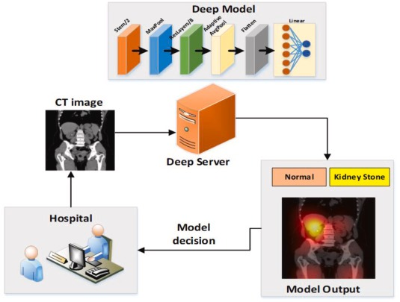
PROPOSED METHODOLOGY
4. Model Evaluation
Evaluate model performance using accuracy.
Use the unseen testing set for evaluation to assess generalizability.
Consider comparisons with existing diagnostic methods to highlight improvements and potential areas for improvement.
5. Desktop Application Development (Optional)
Develop a desktop application for accessibility:
Allow healthcare providers to upload CT images(PNG format).
Provide real-time diagnostic results.
Frontend: Design for user-friendliness
Backend: Implement frameworks like Tkinter for Image processing.
Model inference (running predictions on new data).

Slide 11
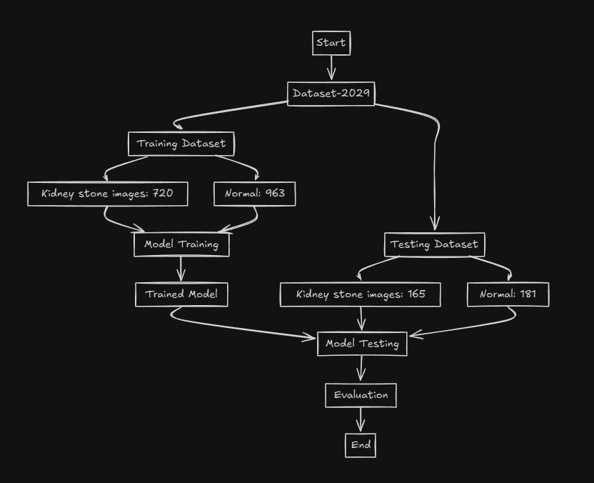
DATASET FLOWCHART:

Slide 12




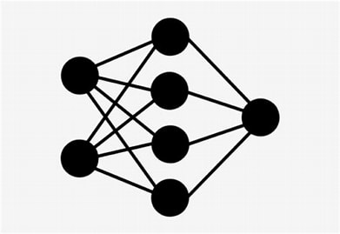
METHODOLOGY FLOWCHART
User Interface
Datasets
Data Preprocessing
User
Training data
Testing data
Result prediction
CNN (Sequential)
VALIDATION OF CNN MODEL

Slide 13
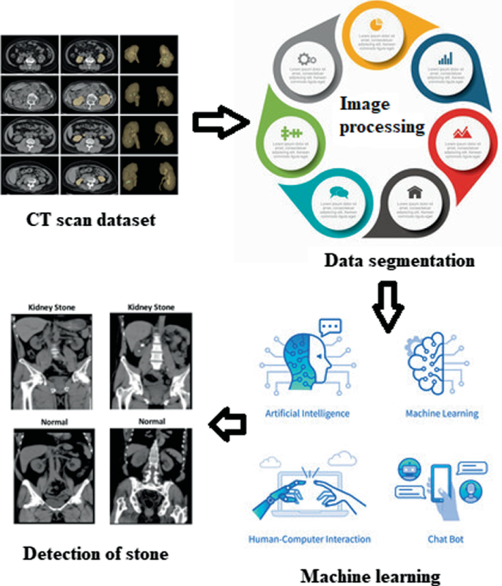
CHALLENGES FACED
Challenge: 1. Data Diversity and Quality
Acquiring a comprehensive dataset that reflects real-world variations.
Medical images vary in quality, resolution, and patient anatomy.
Diverse cases, imaging conditions, and patient demographics needed.
Impact: A limited dataset can lead to a biased and unreliable model.
Solution: Collaborate with multiple medical institutions for data collection.
Ensure accurate labeling of images for training.
Challenge: 2 Model Interpretability
Understanding how CNNs arrive at a diagnosis (often called "black boxes").
Impact: Reduced trust from healthcare professionals due to lack of transparency.
Balance model complexity with interpretability for user trust.

Slide 14

CHALLENGES FACED
Challenge: 3 Integration with Clinical Workflows
Seamlessly integrating the model into existing healthcare routines.
Impact: A cumbersome system might not be adopted by busy healthcare professionals.
Solution: Develop a user-friendly web application with compatibility for existing systems. Gather feedback from end-users during design and testing to address practical challenges.
Challenge: 4 Ensuring Security and Compliance
Meeting strict regulations for handling medical data (e.g., HIPAA compliance).
Impact: Data breaches or privacy violations can erode trust and have legal consequences.
Solution: Implement robust security measures like encryption, secure data transmission, and user authentication.
Conduct regular audits and updates to address vulnerabilities and maintain compliance

Slide 15





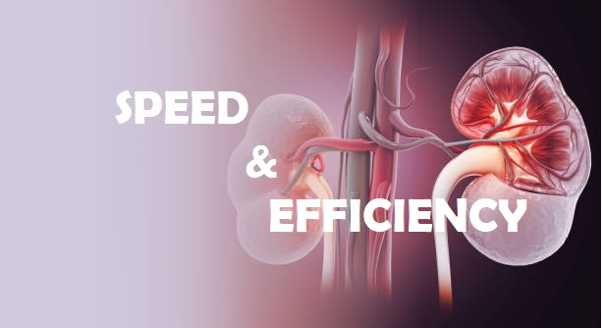
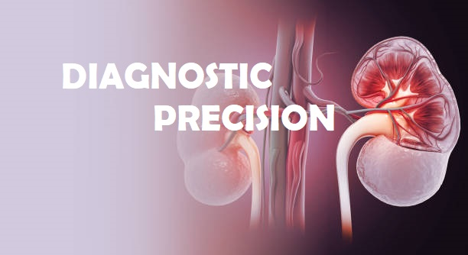

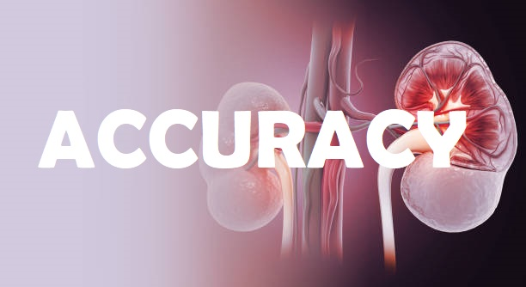
ADVANTAGES

Slide 16
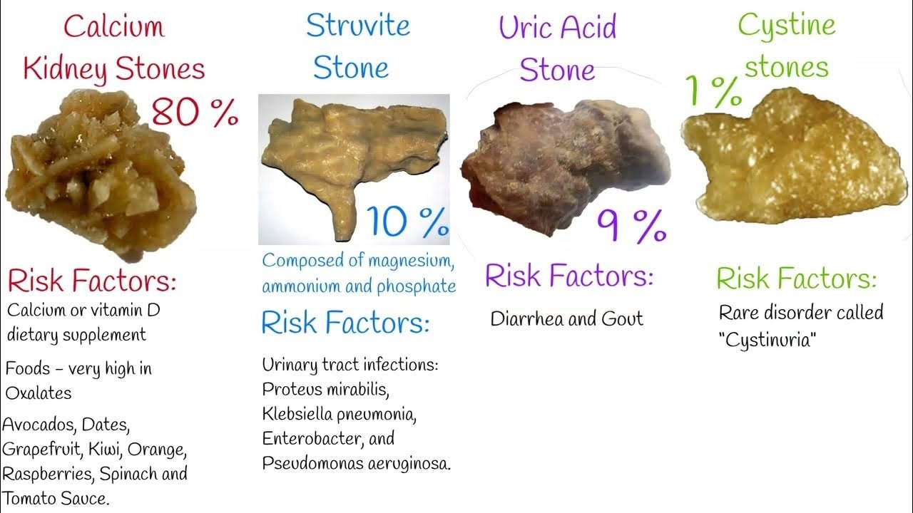
ACCURACY
Enhanced Detection :
Machine learning algorithms, particularly Convolutional Neural Networks (CNNs), can analyze CT scan and ultrasound images with high precision, detecting even the smallest kidney stones that might be missed by traditional methods.
Consistency :
Unlike human interpretation, machine learning models provide consistent and objective analysis, reducing the likelihood of diagnostic errors due to fatigue or subjective judgment.

Slide 17
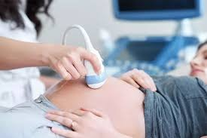
SAFTEY & COMFORT
Non-invasive Methods :
CT scans and ultrasound are non-invasive, minimizing patient discomfort compared to procedures like intravenous pyelogram (IVP) or invasive sampling.
Radiation-Free Option :
Ultrasound imaging, in particular, offers a radiation-free alternative, making it safer for repeated use, especially in vulnerable populations like pregnant women and children.

Slide 18
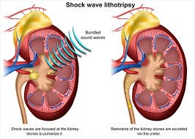
SPEED & EFFICIENCY
Rapid Analysis :
Machine learning models can quickly process large volumes of CT and ultrasound images, providing rapid diagnostic results. This speeds up the decision-making process, allowing for timely treatment.
Workflow Integration :
The integration of machine learning models into clinical workflows can streamline operations, reducing the time healthcare providers spend on manual image analysis and allowing them to focus on patient care.

Slide 19
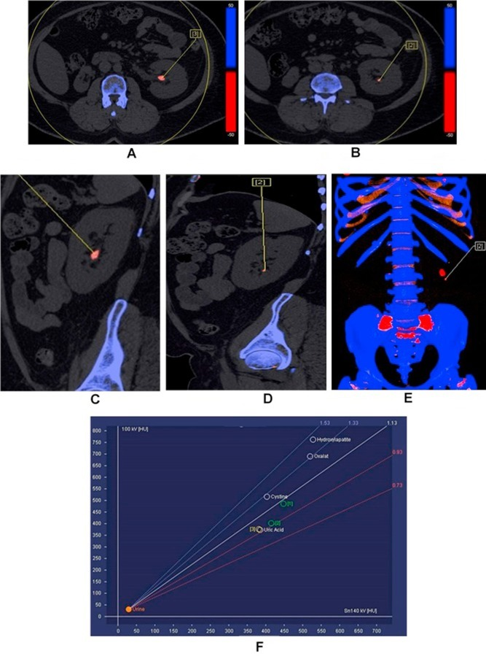
DIAGNOSTIC PRECISION
Detailed Imaging :
CT scans provide highly detailed images that aid in the precise localization and characterization of kidney stones. Machine learning models can further enhance this precision by accurately identifying and classifying stones.
Type Differentiation :
Advanced techniques like dual-energy CT (DECT) can differentiate between different types of kidney stones, such as uric acid and calcium stones, allowing for tailored treatment strategies. Machine learning can assist in this differentiation by analyzing the specific features of each stone type

Slide 20




APPLICATIONS

Slide 21

CLINCAL APPLICATIONS
Use in Hospitals and Clinics:
Integration with existing diagnostic systems to provide quicker and more accurate kidney stone detection.
Assist radiologists by highlighting potential areas of concern in imaging studies. - Reduce human error and increase diagnostic confidence.
Enhanced Patient Management:
Enable personalized treatment plans based on the precise location and size of kidney stones. -
Monitor patients' progress post-treatment to prevent recurrence.

Slide 22

Telemedicine & ContinuousMonitoring
Telemedicine:
Remote diagnosis using patient-uploaded images.
Save time and resources by reducing in-person visits.
Continuous Monitoring:
Wearable devices for early detection in at-risk patients.
Provide real-time data for immediate intervention.

Slide 23
CONCLUSION
Summary:
Developed an ML model for accurate kidney stone detection.
Benefits: early detection, personalized treatment, remote monitoring.
Future Work:
Enhance model with larger datasets and advanced algorithms.
Integrate with clinical systems, expand to other conditions.
Final Thoughts:
Demonstrates AI's potential in healthcare diagnostics.
Continuous innovation and collaboration are key to better patient outcomes

Slide 24
REFERENCES
1. Journals and Research Papers:
- Smith, J. et al. "Machine Learning in Healthcare: Kidney Stone Detection." Journal of Medical Imaging, 2022.
- Johnson, A. et al. "Comparative Study of Machine Learning Algorithms for Kidney Stone Detection." IEEE Transactions on Biomedical Engineering, 2021.
2. Websites:
- Mayo Clinic. "Kidney Stones." [Mayo Clinic](https://www.mayoclinic.org/diseases-conditions/kidney-stones/symptoms-causes/syc-20355755), 2023.
- National Kidney Foundation. "Kidney Stones." [National Kidney Foundation](https://www.kidney.org/atoz/content/kidneystones), 2023.
3. Datasets:
https://github.com/muhammedtalo/Kidney_stone_detection%20/stone/

Slide 25
THANK YOU

